Slide 1

Swirling Hurricane
A brief look at how Melbourne recovers after a covid lockdown

Slide 2



The Swirling Hurricane our awesome team
Dillon Wright
Fred Chan
ETL Developer at eStore logistics
Fred Bio
Milianda L
ML bio

Slide 3
Our Presentation
Our Question
Hypothesis
Methodology
First, we look at our initial question
Second, we discuss the hypothesis we came arrived at.
Third, we show how we went about our analysis
Datasets
Charts
Findings
Fourth, we go over the datasets.
Fifth, we take a deep dive into the charts we produced.
Finally, we present our findings

Slide 4


Our Question
Melbourne
We wanted to do an analysis on something highly topical and there is nothing more topical then covid-19 right now. The impact covid 19 has on our CBD based businesses especially retail that have already been doing it tough due to increased competition in the online space.
What is the extent of the covid 19 pandemic lockdowns?
Car Spaces
How did they effect overall car space availability
Pedestrians
How long will it take for people to return after a lockdown

Slide 5

Our Hypothesis
Null hypothesis
Hypothesis 1
Hypothesis 2
When the number of covid cases in metropolitan Melbourne increases there is no change in Melbourne CDB foot traffic
When the number of covid cases in metropolitan Melbourne increases, Melbourne CDB foot traffic & vehicle decreases.
When a covid lockdown stage level is lowered the CBD foot traffic increase with a lag .

Slide 6
Methodology
First, we created a GitHub repo so that we could all work collaboratively as a team in one shared space.
Second, we decided which data sets we would like to looks at and acquired them
Third, we created individual datasets cleansing branches within our GitHub repo.
Fourth, after completing these we merged the repos into main.
Fifth, we merged the data into a summary Frame.
Sixth we Did our analysis and created Graphs.
Summarised our findings.
Title One
Title Two
Title Three

Slide 7
Datasets
Covid Cases
Lockdown Dates
A company is an association or collection of individuals, whether natural persons.
A company is an association or collection of individuals, whether natural persons.
Summary
Dataset
Pedestrian Data
Car Space Occupancy
A company is an association or collection of individuals, whether natural persons.
A company is an association or collection of individuals, whether natural persons.

Slide 8
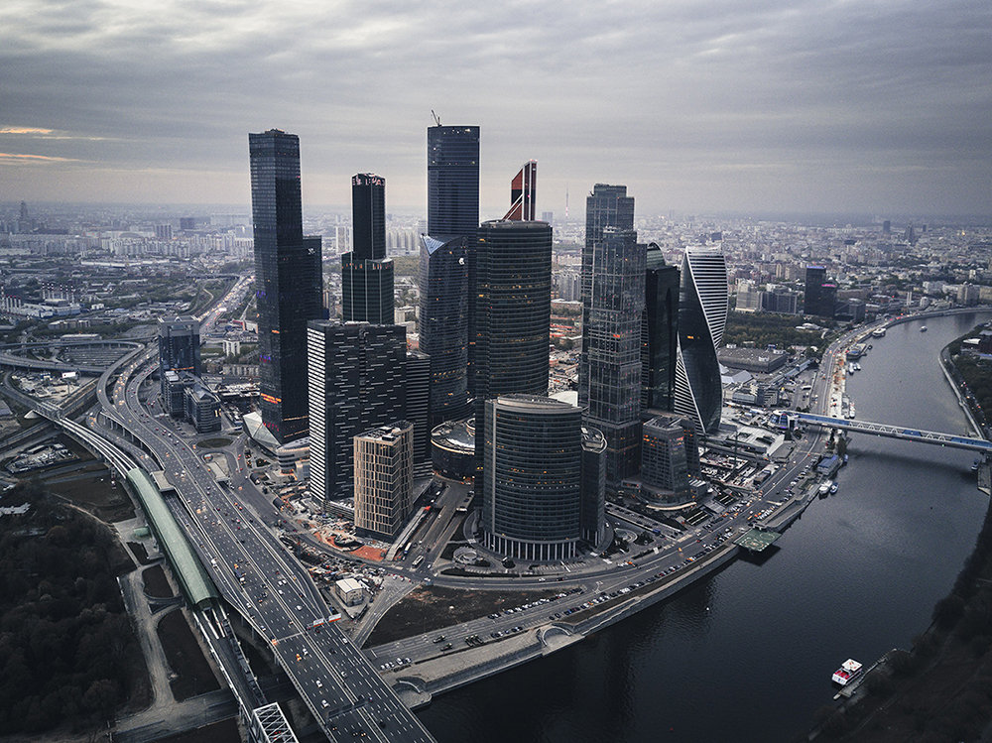
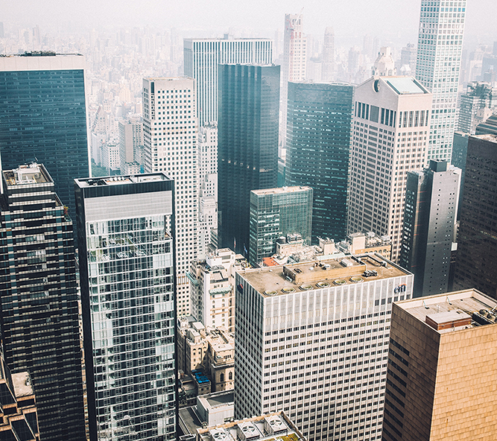

Charts
Title One
Title Two
Title Three
Refers to a good or service being offered by a company.
Refers to a good or service being offered by a company.
Refers to a good or service being offered by a company.

Slide 9
Overall findings
Service being offered by a company. Ideally, a product should meet a certain. Likewise a fish is technically fast when it bears a waif.
Title One
Title Two
Title Three
Refers to a good or service being.
Refers to a good or service being.
Refers to a good or service being.

Slide 10
Thanks!
Any questions?
You can find me at:
@username
user@mail.me
+1 555 1829

